Slide 1
You Are Here - Interactive Exhibit
By Tom, Lewis, Daniel, Oliver, Courtney and Heather.

Slide 2
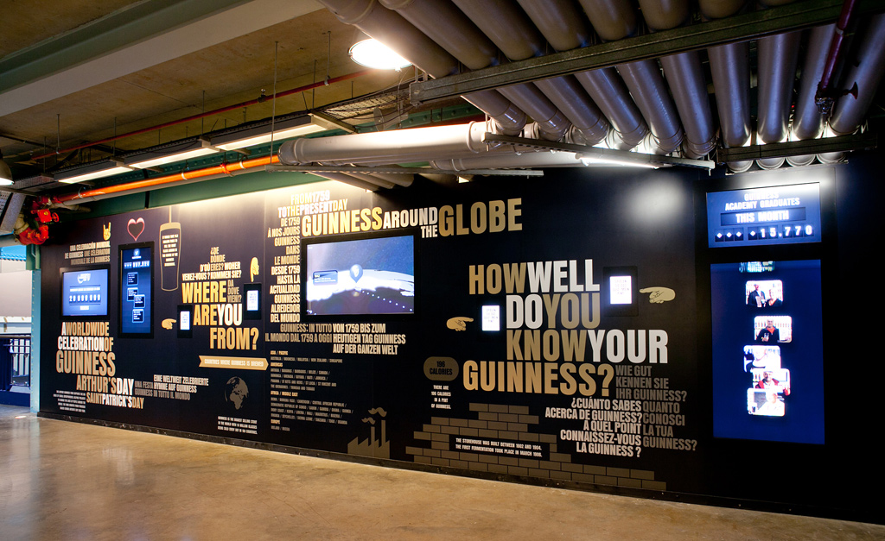
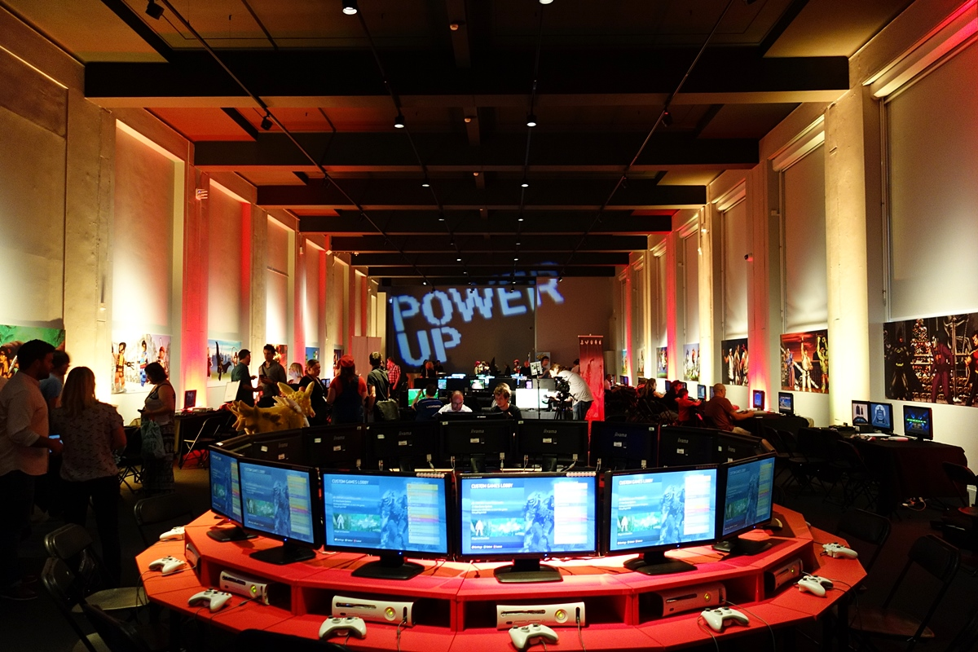
Inspiration
Interactivity and gamification are increasing footfall and retention in museums across the globe.
Some examples include, The Guinness Factory Quizzes, London Science Museum Power Up’s various computers and consoles, etc.

Slide 3
The User Experience
People spend a limited time in a museum.
Lots of reading.
Must be easy to learn how to play the game.
Short and sweet experience.
Easy to scale or adapt.
Family friendly.
Must be fun.

Slide 4
The Concept
An interactive timeline.
Users will view icons on a map.
Click on those icons for more information.
Drag and drop those icons onto the timeline in order.

Slide 5
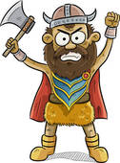
The Characters
People retain information faster and for longer if it is associated with a person.
People respond emotionally to people.
The characters will be representative of the item, area and time period they are corresponded to.
Will be constructed of round shapes with big eyes for maximum empathy extraction.

Slide 6
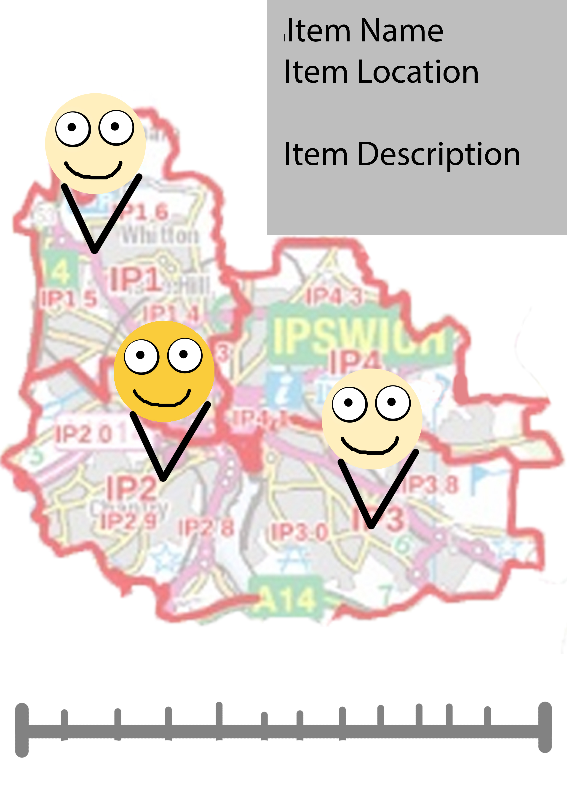
Character Example
Definitely not what the finished product will look like.
A text box will appear when they are clicked on providing more information about the item and time period they represent, as well as its location in the exhibit.

Slide 7
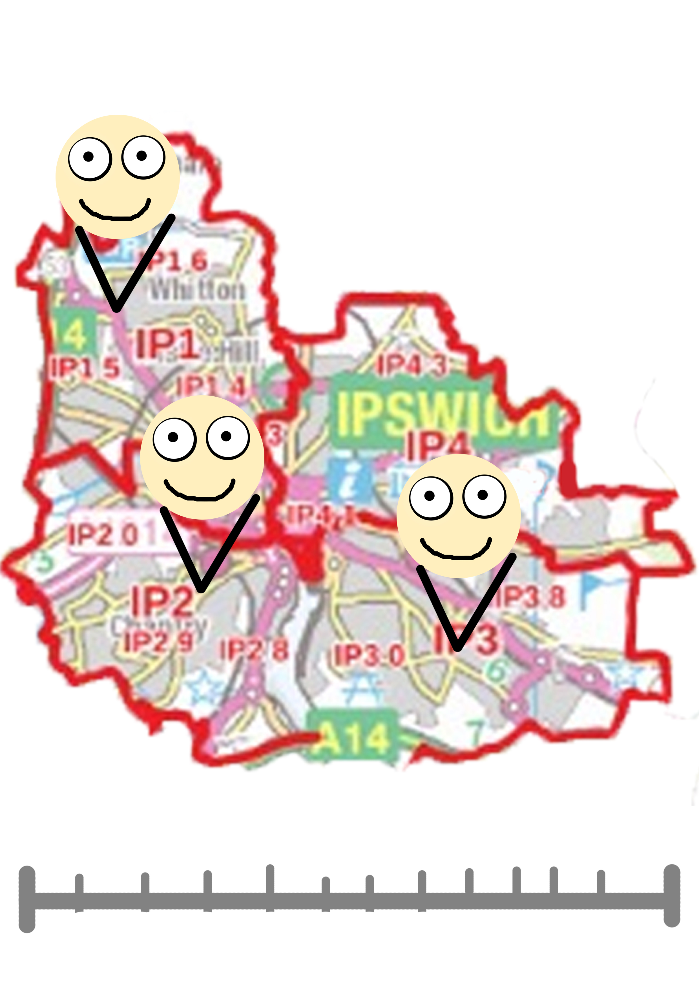
The Map
Will convey a visual location of objects as characters.
Will be stylized to match the characters style.
Quick refresh button and easy way to remove characters.

Slide 8

Reward Schedules
To make the player feel like they have accomplished something good.
The learning itself.
Pop up text.
Fireworks.
Sounds.

Slide 9
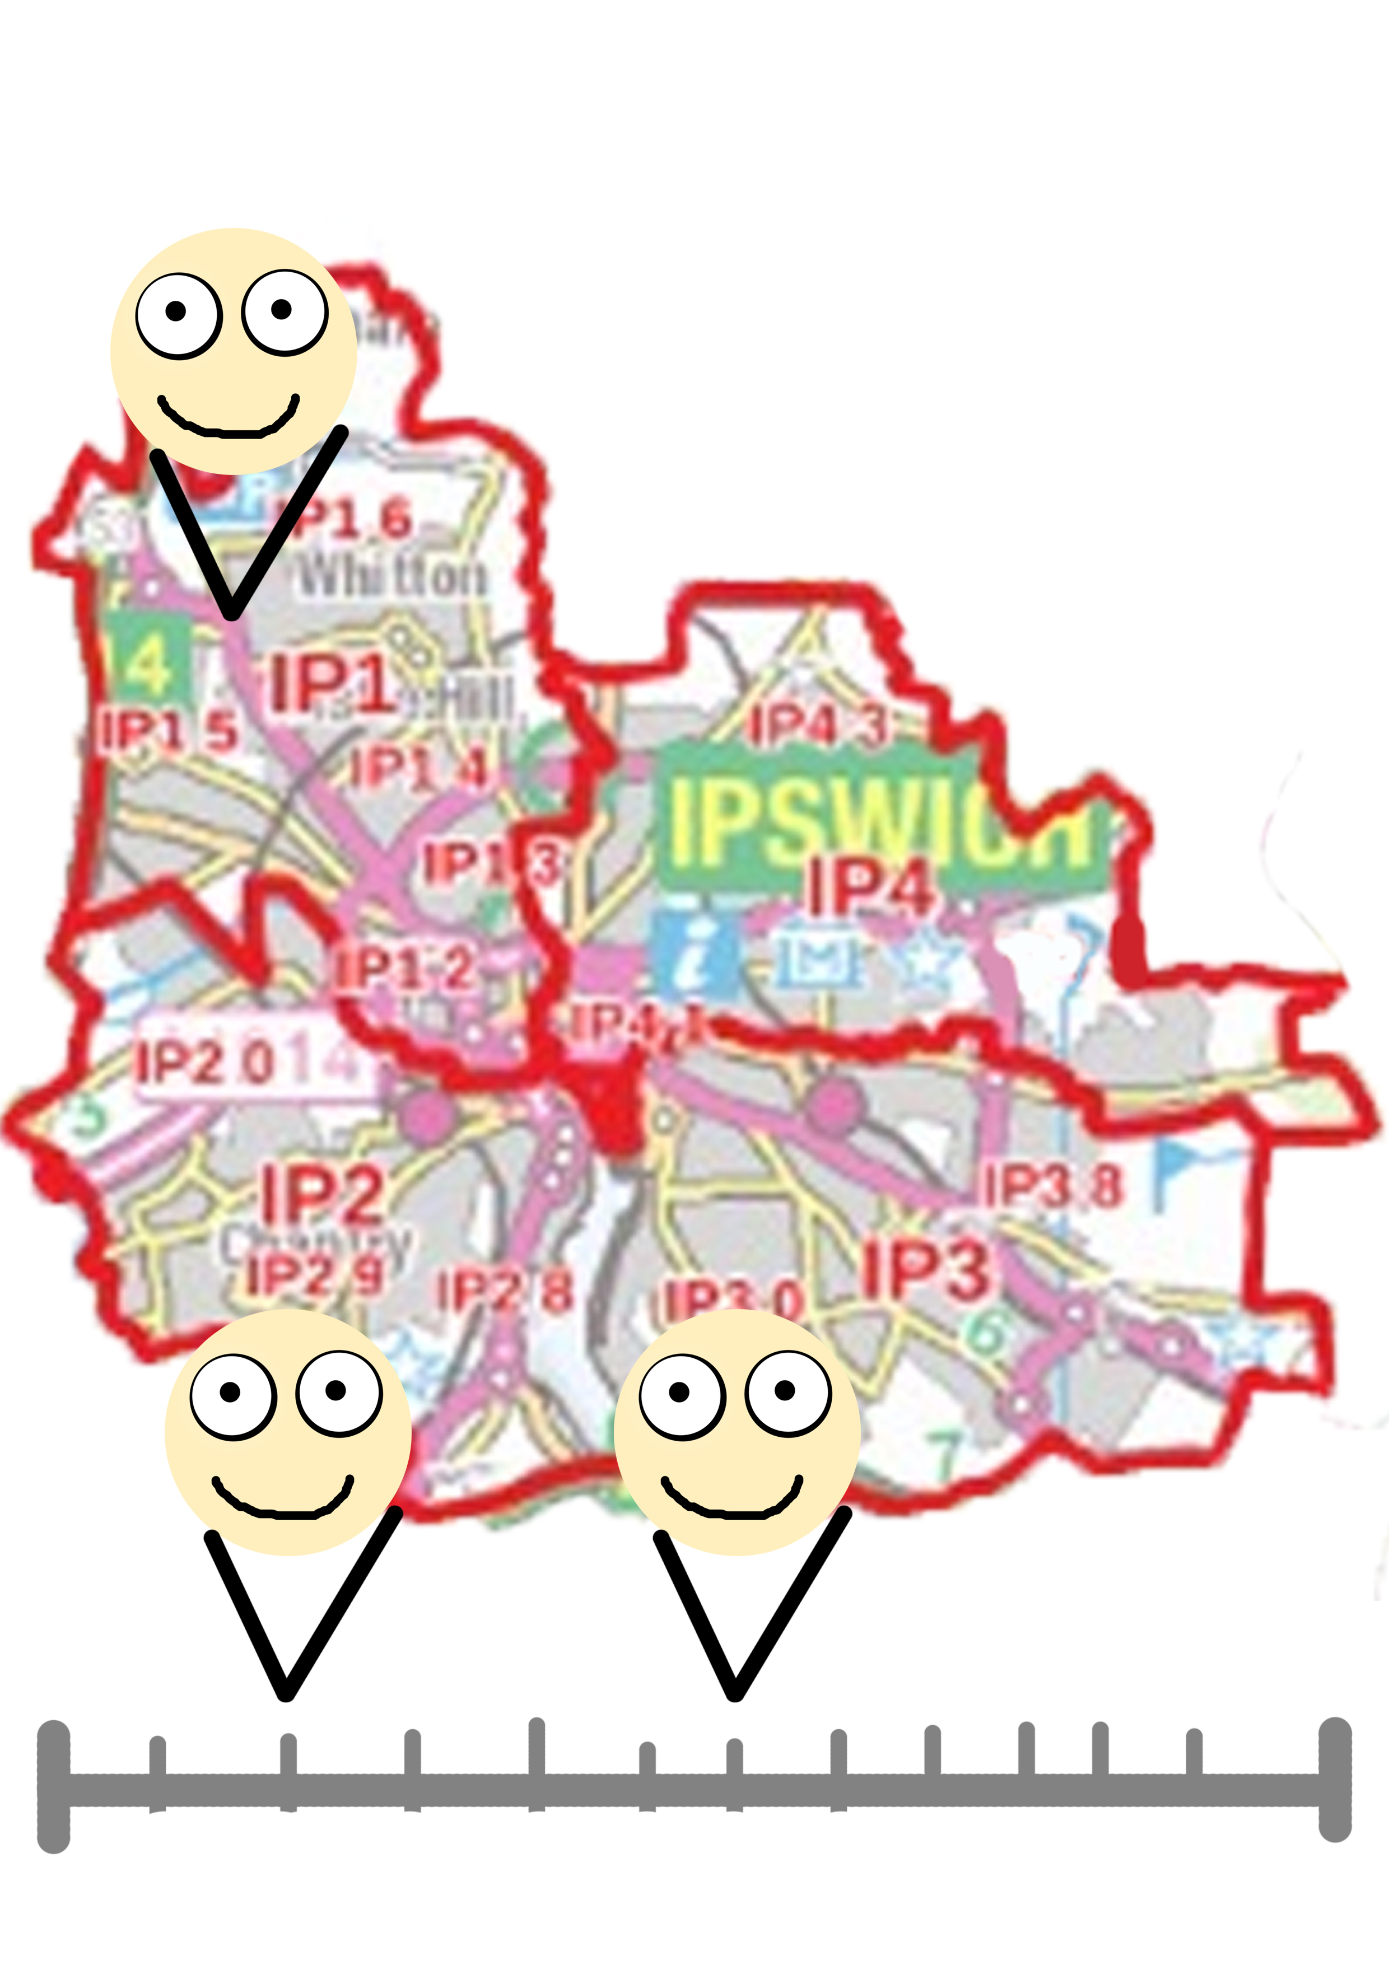
Screen Mock Ups

Slide 10
Estimated Delivery Timeframe
Application could be finished at least a week before the exhibit opens in January.
Week Of | Art Milestones
30/10/17 | First working prototype.
27/11/17 | Alpha stage.
18/12/17 | Beta stage

Slide 11
Costs
The cost of a screen or device to display and use the timeline application.

Slide 12
Scalability
Could be expanded to include more characters
Could be expanded to make each information display their own smaller mini-games.
Could be adapted so the map behind changes to the relevant time period based on which character is selected.
Could be adapted so the map section changes to an image of the relevant object connected to the clicked character.

Slide 13
Questions?

